Slide 1
CAP442 Web Technology
Unit II
Session 7
II Year M.C.A

Slide 2
Contents
Java Scripit
Objects
Creating objects
Using literals
Using new keyword
Using constructor function
Adding and deleting properties
Object Methods
Adding and deleting methods
Displaying Objects
Classes
Inheritance
Window Object
Document Object

Slide 3
Contents
Java Script
Standard Objects
String Objects
Array Objects
Date Objects
Math Object
Window Object
Document Object
Element Objects

Slide 4
Java Script Methods
JavaScript Methods
JavaScript methods are actions that can be performed on objects.
A JavaScript method is a property containing a function definition.
Property Value
firstName John
lastName Doe
age 50
eyeColor blue
fullName function() { return this.firstName + " " + this.lastName;}
Methods are functions stored as object properties.

Slide 5
Java Script Methods
JavaScript Object Methods
Example
const person = {
firstName: "John",
lastName: "Doe",
id: 5566,
fullName: function() {
return this.firstName + " " + this.lastName;
}
};

Slide 6
Java Script Methods
Accessing Object Methods
You access an object method with the following syntax:
objectName.methodName()
You will typically describe fullName() as a method of the person object, and fullName as a property.
The fullName property will execute (as a function) when it is invoked with ().
This example accesses the fullName() method of a person object:
Example
name = person.fullName();
If you access the fullName property, without (), it will return the function definition

Slide 7
Java Script Methods
Adding a Method to an Object
Adding a new method to an object is easy:
Example
person.name = function () {
return this.firstName + " " + this.lastName;
};

Slide 8
Java Script Methods
Using Built-In Methods
This example uses the toUpperCase() method of the String object, to convert a text to uppercase:
let message = "Hello world!";
let x = message.toUpperCase();
The value of x, after execution of the code above will be:
HELLO WORLD!
Example
person.name = function () {
return (this.firstName + " " + this.lastName).toUpperCase();
};

Slide 9
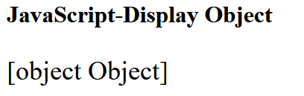
Displaying Java Script Objects
Displaying JavaScript Objects:
Displaying a JavaScript object will output [object Object].
Example
const person = {
name: "John",
age: 30,
city: "New York"
};
document.getElementById("demo").innerHTML = person;

Slide 10
Displaying Java Script Objects
Some common solutions to display JavaScript objects are:
Displaying the Object Properties by name
Displaying the Object Properties in a Loop
Displaying the Object using Object.values()
Displaying the Object using JSON.stringify()

Slide 11
Displaying Java Script Objects
Displaying Object Properties
The properties of an object can be displayed as a string:
Example
const person = {
name: "John",
age: 30,
city: "New York"
};
document.getElementById("demo").innerHTML =
person.name + "," + person.age + "," + person.city;

Slide 12
Displaying Java Script Objects
Displaying the Object in a Loop
The properties of an object can be collected in a loop:
Example
const person = {
name: "John",
age: 30,
city: "New York"
};
for (let x in person) {
document.write(“<h1>”+ person[x] + “</h1>”);
};

Slide 13
Displaying Java Script Objects
You must use person[x] in the loop.
person.x will not work (Because x is a variable).

Slide 14
Displaying Java Script Objects
Using Object.values()
Any JavaScript object can be converted to an array using Object.values():
const person = {
name: "John",
age: 30,
city: "New York"
};
const myArray = Object.values(person);
document.getElementById("demo").innerHTML = myArray;
myArray is now a JavaScript array, ready to be displayed:

Slide 15
Displaying Java Script Objects
Using JSON.stringify()
Any JavaScript object can be stringified (converted to a string) with the JavaScript function JSON.stringify():
const person = {
name: "John",
age: 30,
city: "New York"
};
let myString = JSON.stringify(person);
document.getElementById("demo").innerHTML = myString;

Slide 16
Displaying Java Script Objects
The result will be a string following the JSON notation:
{"name":"John","age":50,"city":"New York"}

Slide 17
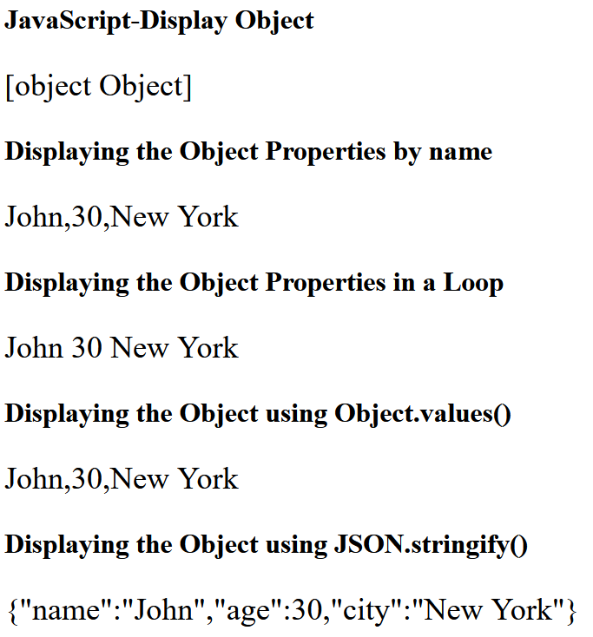
Displaying Java Script Objects

Slide 18
Built-in JavaScript Constructors
JavaScript has built-in constructors for native objects:
new String() // A new String object
new Number() // A new Number object
new Boolean() // A new Boolean object
new Object() // A new Object object
new Array() // A new Array object
new RegExp() // A new RegExp object
new Function() // A new Function object
new Date() // A new Date object
The Math() object is not in the list. Math is a global object. The new keyword cannot be used on Math

Slide 19
JavaScript Classes
ECMAScript 2015, also known as ES6, introduced JavaScript Classes.
JavaScript Classes are templates for JavaScript Objects.
Use the keyword class to create a class.
Always add a method named constructor():
Syntax
class ClassName {
constructor() { ... }
}

Slide 20
JavaScript Classes
Example
class Car {
constructor(name, year) {
this.name = name;
this.year = year;
}
}
The example above creates a class named "Car".
The class has two initial properties: "name" and "year".
A JavaScript class is not an object.
It is a template for JavaScript objects.

Slide 21
JavaScript Classes
Using a Class
When you have a class, you can use the class to create objects:
Example
let myCar1 = new Car("Ford", 2014);
let myCar2 = new Car("Audi", 2019);
The example above uses the Car class to create two Car objects.
The constructor method is called automatically when a new object is created.

Slide 22
JavaScript Classes
The Constructor Method
The constructor method is a special method:
It has to have the exact name "constructor"
It is executed automatically when a new object is created
It is used to initialize object properties
If you do not define a constructor method, JavaScript will add an empty constructor method.

Slide 23
JavaScript Classes
Class Methods
Class methods are created with the same syntax as object methods.
Use the keyword class to create a class.
Always add a constructor() method.
Then add any number of methods.
Syntax
class ClassName {
constructor() { ... }
method_1() { ... }
method_2() { ... }
method_3() { ... }
}

Slide 24
JavaScript Classes
Create a Class method named "age", that returns the Car age:
Example
class Car {
constructor(name, year) {
this.name = name;
this.year = year;
}
age() {
let date = new Date();
return date.getFullYear() - this.year;
}
}
let myCar = new Car("Ford", 2014);
document.getElementById("demo").innerHTML =
"My car is " + myCar.age() + " years old.";

Slide 25
JavaScript Classes
You can send parameters to Class methods:
Example
class Car {
constructor(name, year) {
this.name = name;
this.year = year;
}
age(x) { return x - this.year; }
}
let date = new Date();
let year = date.getFullYear();
let myCar = new Car("Ford", 2014);
document.getElementById("demo").innerHTML=
"My car is " + myCar.age(year) + " years old.";

Slide 26
JavaScript Class Inheritance
To create a class inheritance, use the extends keyword.
A class created with a class inheritance inherits all the methods from another class
Create a class named "Model" which will inherit the methods from the "Car" class:

Slide 27
JavaScript Class Inheritance
class Car {
constructor(brand) {
this.carname = brand;
}
present() {
return 'I have a ' + this.carname;
}
}
class Model extends Car {
constructor(brand, mod) {
super(brand);
this.model = mod;
}
show() {
return this.present() + ', it is a ' + this.model;
}
}
let myCar = new Model("Ford", "Mustang");
document.getElementById("demo").innerHTML = myCar.show();

Slide 28
JavaScript Class Inheritance
The super() method refers to the parent class.
By calling the super() method in the constructor method, we call the parent's constructor method and gets access to the parent's properties and methods.
Inheritance is useful for code reusability: reuse properties and methods of an existing class when you create a new class.

Slide 29
Window Object
The window object represents an open window in a browser.
If a document contain frames (<iframe> tags), the browser creates one window object for the HTML document, and one additional window object for each frame.

Slide 30
Window Object Properties
Property Description
closed Returns a Boolean value indicating whether a window has been closed or not
console Returns a reference to the Console object, which provides methods for logging information to the browser's console (See Console object)
defaultStatus Sets or returns the default text in the statusbar of a window
document Returns the Document object for the window (See Document object)
frameElement Returns the <iframe> element in which the current window is inserted
frames Returns all <iframe> elements in the current window
history Returns the History object for the window (See History object)

Slide 31
Property Description
innerHeight Returns the height of the window's content area (viewport) including scrollbars
innerWidth Returns the width of a window's content area (viewport) including scrollbars
length Returns the number of <iframe> elements in the current window
localStorage Allows to save key/value pairs in a web browser. Stores the data with no expiration date
location Returns the Location object for the window (See Location object)
name Sets or returns the name of a window
navigator Returns the Navigator object for the window (See Navigator object)
opener Returns a reference to the window that created the window

Slide 32
Property Description
outerHeight Returns the height of the browser window, including toolbars/scrollbars
outerWidth Returns the width of the browser window, including toolbars/scrollbars
pageXOffset Returns the pixels the current document has been scrolled (horizontally) from the upper left corner of the window
pageYOffset Returns the pixels the current document has been scrolled (vertically) from the upper left corner of the window
parent Returns the parent window of the current window
screen Returns the Screen object for the window (See Screen object)
screenLeft Returns the horizontal coordinate of the window relative to the screen

Slide 33
Property Description
screenTop Returns the vertical coordinate of the window relative to the screen
screenX Returns the horizontal coordinate of the window relative to the screen
screenY Returns the vertical coordinate of the window relative to the screen
sessionStorage Allows to save key/value pairs in a web browser. Stores the data for one session
scrollX An alias of pageXOffset
scrollY An alias of pageYOffset
self Returns the current window
status Sets or returns the text in the statusbar of a window
top Returns the topmost browser window

Slide 34
Window Object Methods
Method Description
alert() Displays an alert box with a message and an OK button
atob() Decodes a base-64 encoded string
blur() Removes focus from the current window
btoa() Encodes a string in base-64
clearInterval() Clears a timer set with setInterval()
clearTimeout() Clears a timer set with setTimeout()
close() Closes the current window
confirm() Displays a dialog box with a message and an OK and a Cancel button
focus() Sets focus to the current window

Slide 35
Method Description
getComputedStyle() Gets the current computed CSS styles applied to an element
getSelection() Returns a Selection object representing the range of text selected by the user
matchMedia() Returns a MediaQueryList object representing the specified CSS media query string
moveBy() Moves a window relative to its current position
moveTo() Moves a window to the specified position
open() Opens a new browser window
print() Prints the content of the current window
prompt() Displays a dialog box that prompts the visitor for input
requestAnimationFrame() Requests the browser to call a function to update an animation before the next repaint

Slide 36
Method Description
resizeBy() Resizes the window by the specified pixels
resizeTo() Resizes the window to the specified width and height
scrollBy() Scrolls the document by the specified number of pixels
scrollTo() Scrolls the document to the specified coordinates
setInterval() Calls a function or evaluates an expression at specified intervals (in milliseconds)
setTimeout() Calls a function or evaluates an expression after a specified number of milliseconds
stop() Stops the window from loading

Slide 37
alert() method:
Displays the alert box containing message with ok button.
<script>
function alertMsg(){
alert("Hello Alert Box");
}
</script>
<input type="button" value="click" onclick="alertMsg()"/>

Slide 38
confirm() method:
Displays the confirm dialog box containing message with ok and cancel button
<script>
function confirmMsg(){
var v= confirm("Are u sure?");
if(v==true){
alert("ok");
}else{
alert("cancel");
}
}
</script>
<input type="button" value="click" onclick="confirmMsg()"/>

Slide 39
prompt() method:
Displays a dialog box to get input from the user.
<script>
function promptMsg(){
var v= prompt("Who are you?");
alert("I am "+v);
}
</script>
<input type="button" value="click" onclick="promptMsg()"/>

Slide 40
open(), close() and moveTo() methods:
<script>
var myWindow;
function openwin2(){
myWindow = window.open("", "myWindow", "width=400, height=200");
myWindow.document.write("<p>A new window!</p>");
}
function closeWin(){
myWindow.close();
}
function moveWin(){
myWindow.moveTo(450,450);
myWindow.focus();
}
</script>
<input type="button" value="open window" onclick="openwin2()"/>
<input type="button" value="Move window" onclick="moveWin()"/>
<input type="button" value="close window" onclick="closeWin()"/>

Slide 41
DOM Document Object
The document object represents your web page.
If you want to access any element in an HTML page, you always start with accessing the document object.
Below are some examples of how you can use the document object to access and manipulate HTML.
Finding HTML Elements
Method Description
document.getElementById(id) Find an element by element id
document.getElementsByTagName(name) Find elements by tag name
document.getElementsByClassName(name) Find elements by class name

Slide 42
Changing HTML Elements
Property Description
element.innerHTML = new html content Change the inner HTML of an element
element.attribute = new value Change the attribute value of an HTML element
element.style.property = new style Change the style of an HTML element
Method Description
element.setAttribute(attribute, value) Change the attribute value of an HTML element

Slide 43
Adding and Deleting Elements
Method Description
document.createElement(element) Create an HTML element
document.removeChild(element) Remove an HTML element
document.appendChild(element) Add an HTML element
document.replaceChild(new, old) Replace an HTML element
document.write(text) Write into the HTML output stream

Slide 44
Adding Events Handlers
Method Description
document.getElementById(id).onclick = function(){code} Adding event handler code to an onclick event

Slide 45
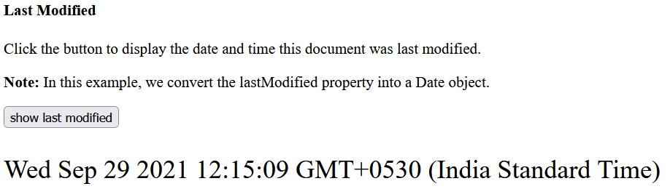
Last modified:
The lastModified property returns the date and time the current document was last modified.
Note: This property is read-only.
<button onclick="showLastModified()">
show last modified</button>
<p id="demo" style="font-size: 24px;"> </p>
<script>
function showLastModified() {
var x = new Date(document.lastModified);
document.getElementById("demo").innerHTML = x;
}
</script>

Slide 46
document.getElementById(id) method:
The getElementById() method returns the element that has the ID attribute with the specified value.
This method is one of the most common methods in the HTML DOM, and is used almost every time you want to manipulate, or get info from, an element on your document.
Returns null if no elements with the specified ID exists.
An ID should be unique within a page. However, if more than one element with the specified ID exists, the getElementById() method returns the first element in the source code.

Slide 47
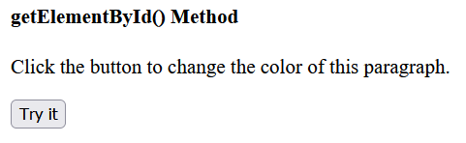
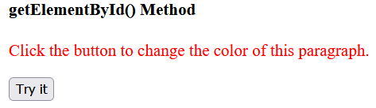
<p id="demo">Click the button to change the color of this paragraph.</p>
<button onclick="myFunction()">Try it</button>
<script>
function myFunction() {
var x = document.getElementById("demo");
x.style.color = "red";
}
</script>

Slide 48
document.getElementsByName() method:
The getElementsByName() method returns a collection of all elements in the document with the specified name (the value of the name attribute), as an HTMLCollection object.
The HTMLCollection object represents a collection of nodes. The nodes can be accessed by index numbers. The index starts at 0.
Find out how many elements there are in the document that have a name attribute with the value "animal" (using the length property of the HTMLCollection object):
var x = document.getElementsByName("animal").length;

Slide 49
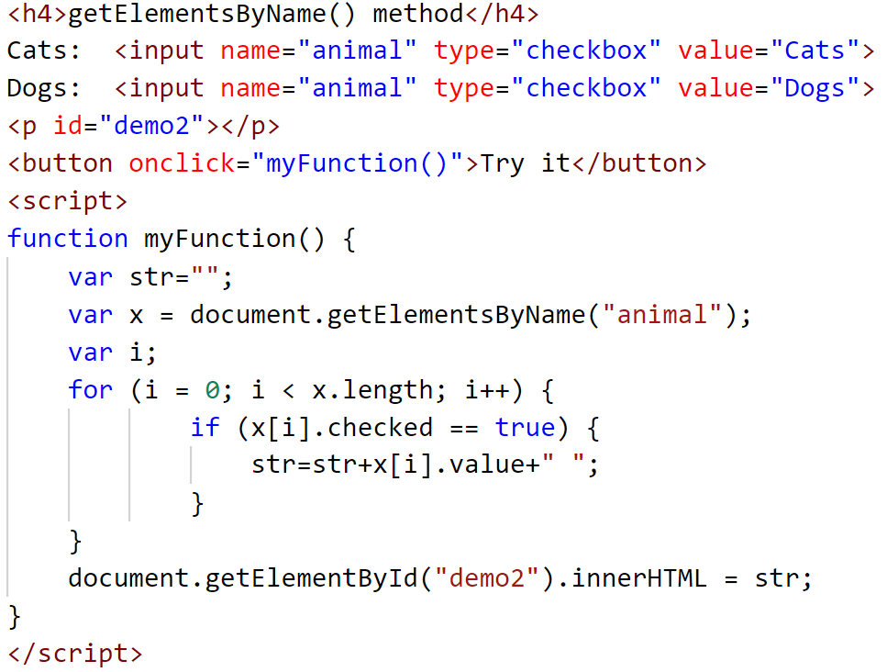
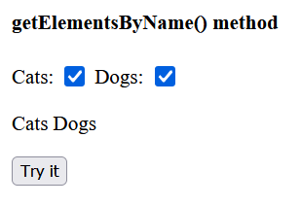
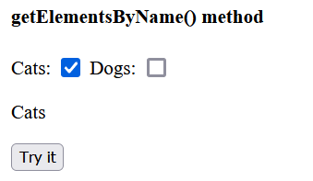
Example: This example display the text values of checked check boxes.

Slide 50
addEventListener() method:
The addEventListener() method attaches an event handler to the specified element.
The addEventListener() method attaches an event handler to an element without overwriting existing event handlers.
You can add many event handlers to one element.
You can add many event handlers of the same type to one element, i.e two "click" events.
You can add event listeners to any DOM object not only HTML elements. i.e the window object.

Slide 51
When using the addEventListener() method, the JavaScript is separated from the HTML markup, for better readability and allows you to add event listeners even when you do not control the HTML markup.
You can easily remove an event listener by using the removeEventListener() method.

Slide 52
Syntax
element.addEventListener(event, function, useCapture);
The first parameter is the type of the event (like "click" or "mousedown" or any other HTML DOM Event.)
The second parameter is the function we want to call when the event occurs.
The third parameter is a boolean value specifying whether to use event bubbling or event capturing. This parameter is optional.
Note that you don't use the "on" prefix for the event; use "click" instead of "onclick".

Slide 53
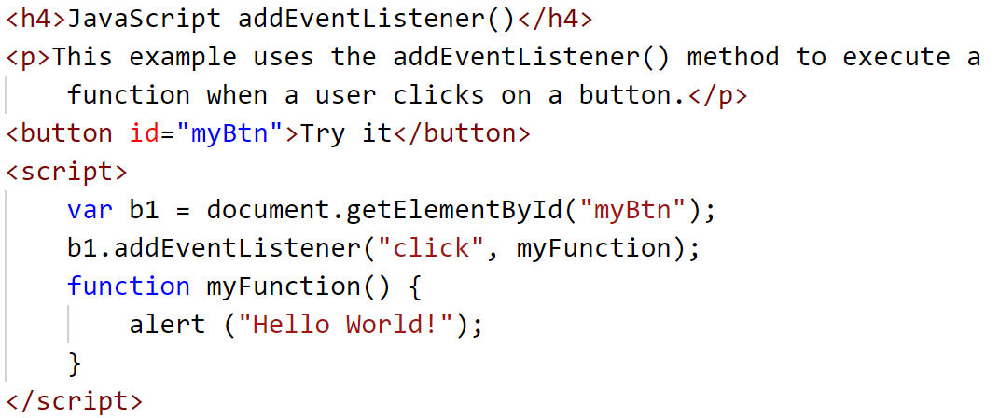

Slide 54
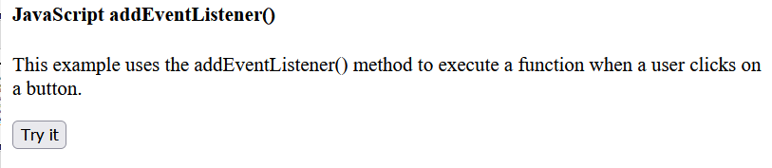
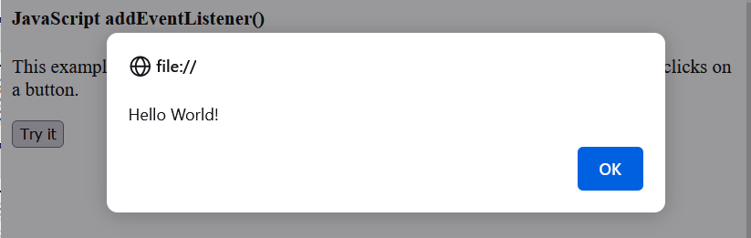

Slide 55
createElement() Method
The createElement() method creates an Element Node with the specified name.
Note: After the element is created, use the element.appendChild() or element.insertBefore() method to insert it to the document.
Syntax
document.createElement(nodename)

Slide 56
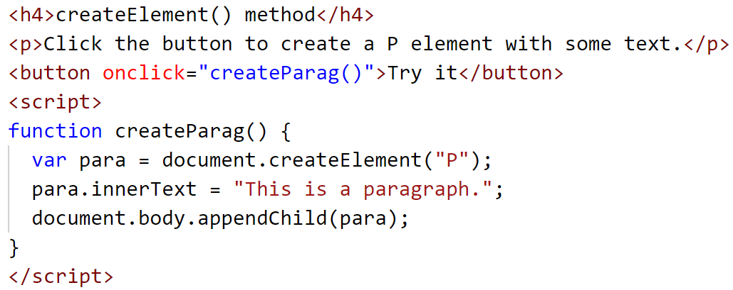
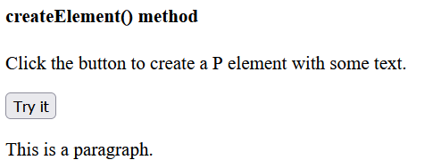
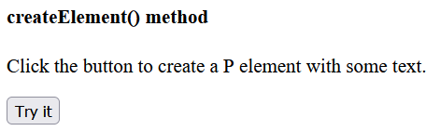

Slide 57
querySelector() Method
The querySelector() method returns the first element that matches a specified CSS selector(s) in the document.
Note: The querySelector() method only returns the first element that matches the specified selectors. To return all the matches, use the querySelectorAll() method instead.
If the selector matches an ID in document that is used several times (Note that an "id" should be unique within a page and should not be used more than once), it returns the first matching element.

Slide 58
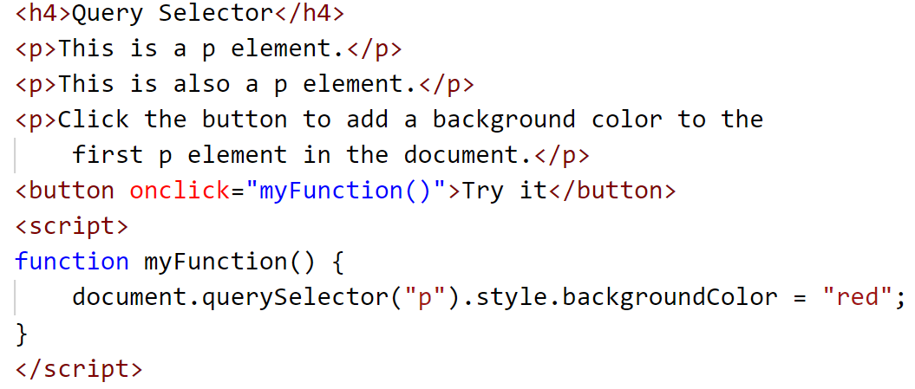

Slide 59
